Slide 1
Clever Nelly Launch Communications
Building user buy-in and long-term engagement
We financially guarantee your employees will learn and retain what you have trained them and provide you best-in-class evidence of such at the click of a button.

Slide 2



Your communication strategy
When senior leaders use a consistent narrative around its ambition and goals, it can make the investment up to 4x more likely to succeed
The message starts with your Clever Nelly Champions
Active communication is essential
Lead with your purpose statement and your Compelling Story

Slide 3
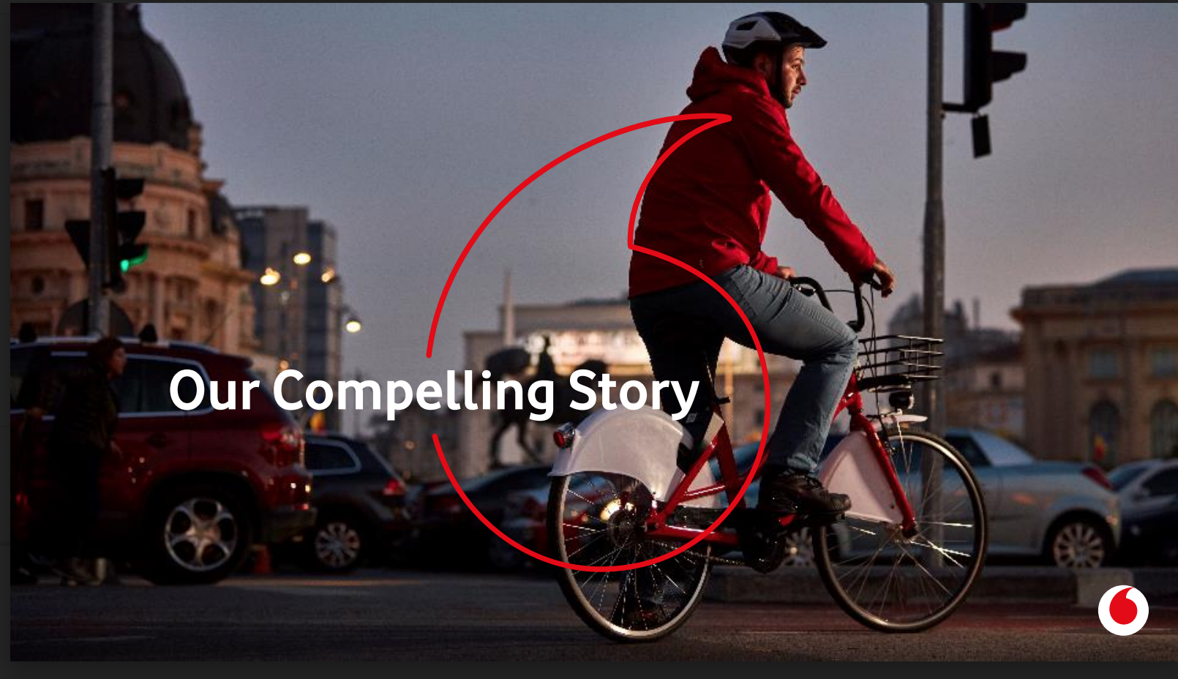
Your Compelling Story
Stories change the way we THINK, ACT & FEEL.
A short story can impact more deeply than any instruction to ‘just do something’. Stories are powerful tools, and successful leaders use them to land change and move performance. If you want to land change, create the story.
We know that consumers are increasingly apprehensive when it comes to online risks. We want to equip you with the knowledge to instil confidence, helping our customers follow basic but necessary practices when using online apps and tools.
Clever Nelly is NOT a testing or quizzing tool.
Clever Nelly will help us close knowledge and competency gaps by offering the right support and training at the right time. It's about helping you be the best you can be.
EXAMPLE
We are asking the senior team to….
Craft the story for change – the ‘why’. What will success look like? How will Nelly support you?
Tell the story! Take the key messages and create your own narrative. You may need to adapt your story to different audiences.
Connect your people to the story; they play a vital role in the success of Nelly.
What is changing?
Where are we now?
Where are we going?
Introduce Clever Nelly
What is the ask?
What does it mean if we get it right?
© Elephants Don’t Forget | www.elephantsdontforget.com | Classification: Confidential

Slide 4

Internally cascading Clever Nelly
Your Compelling Story cannot be half-heartedly sent in a one-off email for someone to read. It has to be told to land with impact.
This could include:
Video messages from key stakeholders
Town halls and senior-led sessions
Positioning Nelly as a formal point to cover in team meetings and one-to-ones
Encouraging key stakeholders to share their own dashboard to their teams to show they are taking part and engaged as well
What will be your mechanism for collating and sharing success stories?
Begin a cultural shift by creating high awareness of Nelly and capturing opinions, concerns and ideas.
Demonstrate tangible action by being clear on your priorities and increasing advocacy of your intent.

Slide 5





Implementing Clever Nely in your Workplace
Priming
Change Perceptions
Act on your Insights
Bring Nelly into 1:1s
Collaborate and Amplify
Get your team thinking about Clever Nelly by introducing visuals in your communications and office space pre-launch.
Consider using posters, digital media and merchandise.
Address any concerns or blockers that arise to gain and maintain buy-in.
Adopt a dedicated space for open dialogue, such as a Teams channel or Yammer.
Read the data and identify areas where knowledge gaps exist to inform any training decisions.
Circulate learning content for common gaps.
Connect with your team and make Nelly a key focus in your professional development conversations with them.
Seek opportunities to gain feedback and expand the question sets within Nelly.
Your Account Director will begin running focus groups with you when the time comes.

Slide 6
Pre-Launch Priming Emails

Slide 7
Priming your team
Priming is a proven way to get into people’s heads and help them land something new.
Speed up memory retrieval
Recognised as an important learning tool
If you tell people in advance what the expectation is, it will land much better
Creates less anxiety and better influences the behaviour you want to see

Slide 8

Introduce Clever Nelly
Hello team,
We are excited to announce that from [launch date], we will be introducing a knowledge retention platform across our [related item] team – Clever Nelly – in recognition of the different ways we want to better support your development.
What will this mean for you?
You will have complete control of your learning experiences and increase your workplace confidence
You will be able to track your knowledge progress – anonymously compared to your peer group
You can engage with Clever Nelly at your own convenience, with daily questions delivered across [email / Teams / Zoom] and taking less than two minutes to complete
At [client name], we take great pride in everything our people accomplish for our business and its customers. Clever Nelly is designed to help us continue to do just that.
Over the coming weeks, you’ll be hearing more about Clever Nelly’s capabilities. If you have any questions or concerns to raise, please contact [add person] directly.
Many thanks,
[Sign off]
Three weeks to launch

Slide 9
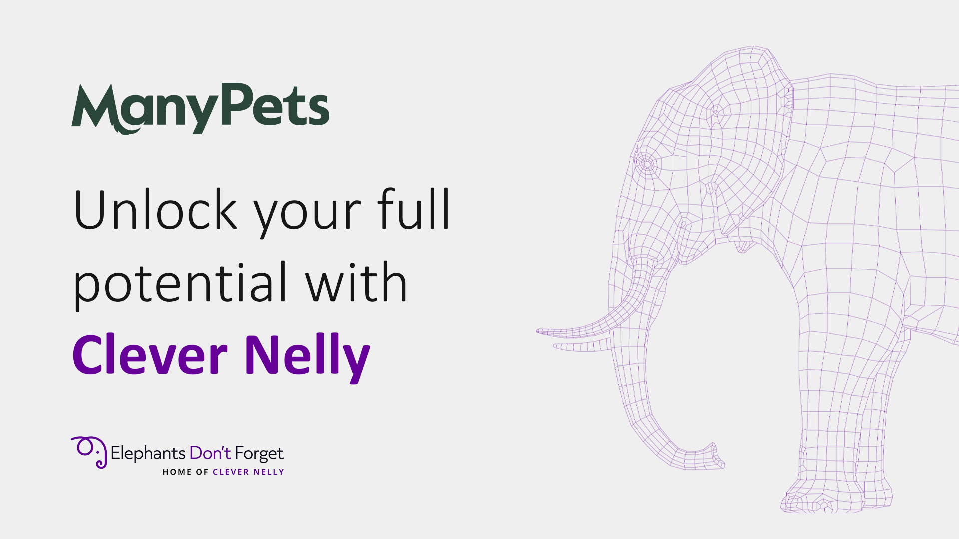
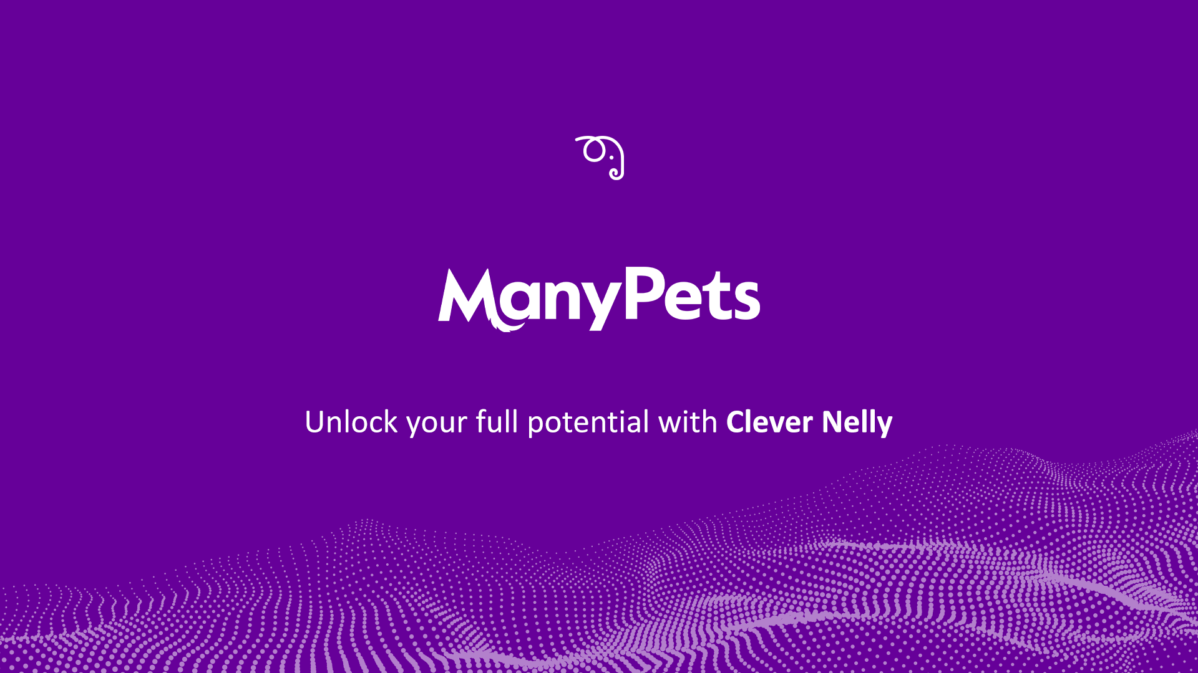
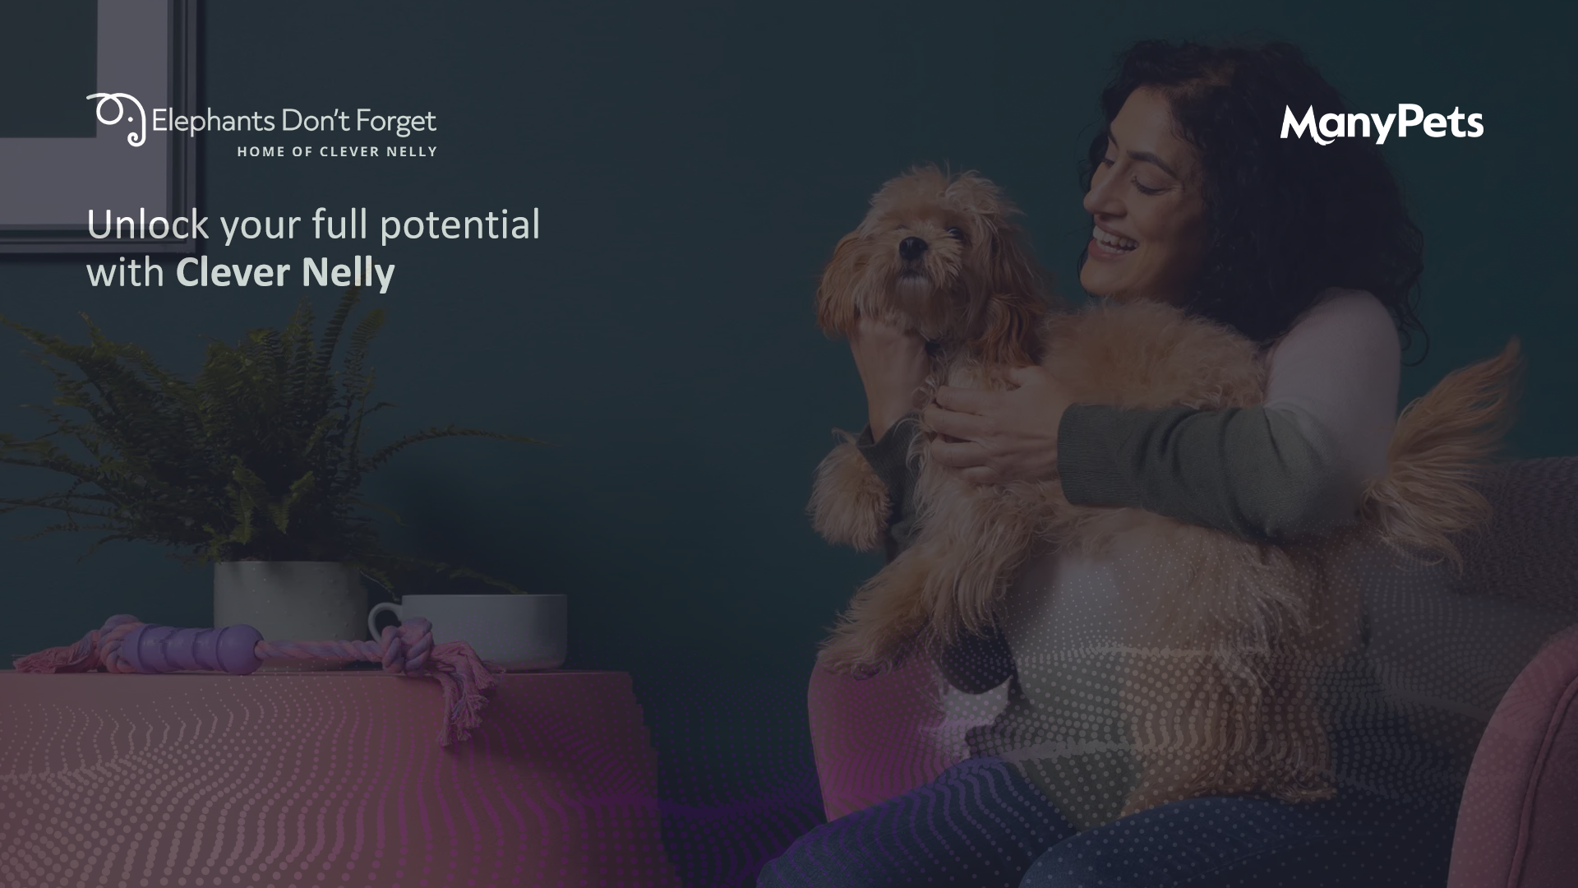
Wider communication tools
How are you planning to embed Clever Nelly into your workplace culture?
MS Teams backgrounds during internal meetings
Create an MS Teams channel, providing your team with an open and direct forum to raise any questions or offer live feedback
Use the digital media available from EDF on TV screens around the office

Slide 10
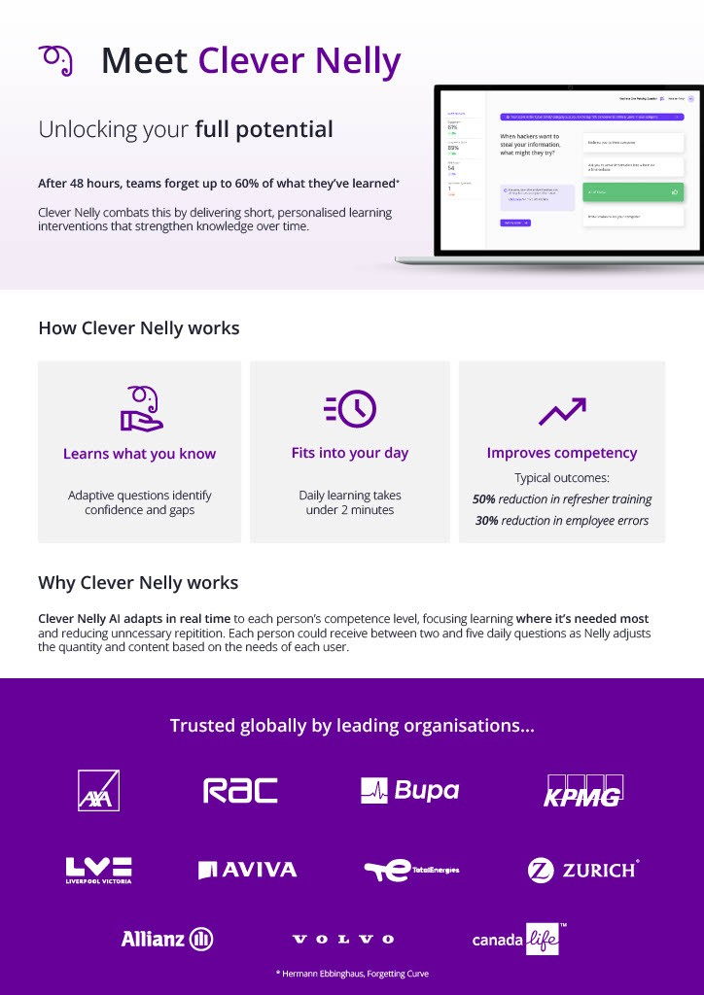
Supporting your launch
Work with your Nelly champions to ensure a cohesive message is being communicated across the whole business. You will also have access to a range of print and digital launch collateral, such as:
Email banners and posters
Raise Nelly’s profile
Bitesize infographics
Pre-launch, attach bitesize visuals to your priming emails to simplify Nelly’s purpose and capabilities

Slide 11
Cascade your Compelling Story
Hello team,
We recently communicated a change in our training practices, with the introduction of Clever Nelly – a knowledge retention platform that utilises Artificial Intelligence to help you better learn and retain business-critical information.
It’s important to us that you understand why we’ve chosen to launch this within the team.
Our day-to-day jobs change over time, along with the expectations of our customers and colleagues. It’s our intention that by working with leading technology – like Clever Nelly from Elephants Don’t Forget – we can highlight training needs on an individual employee basis to ultimately give you the opportunity to progress and for us to achieve our objectives at [client name].
Here’s the story behind our Clever Nelly ambitions:
[Insert Compelling Story]
We believe that by investing in you, we will deliver the best customer outcomes to drive our business forwards.
Your commitment is crucial, so if you have any questions ahead of Clever Nelly’s launch, please contact a member of the team.
Many thanks,
[Sign off]
Two weeks to launch

Slide 12
Pre-emptively address questions
Hello team,
As we get closer to the launch of Clever Nelly, I wanted to supply some additional information to prepare you for the [date].
For the first [six weeks], you will be sent two questions per day so that Nelly can gain insights into what you already know. Whilst these can be completed at any point, it’s important to us as a business that you engage with the tool, as we need a collective push to achieve our goal of [insert Compelling Story snippet].
You will have 30 seconds to complete each multi-choice question, which will be tailored to suit your role.
The purpose behind Clever Nelly is to help you build workplace confidence and capability; not to catch you out. There will be areas where you perform higher and lower than others, but it is Nelly’s job to identify those and structure your learning content to increase or maintain knowledge retention.
Incorrect answers will not be penalised and you will be given the opportunity to have another go within two weeks.
If you have any questions, I’ve included a Q&A document for further reading, or you can contact [add person] directly.
Many thanks,
[Sign off]
One week to launch

Slide 13
Post-Launch Milestones

Slide 14
Nelly’s launch
Hello team,
We’d like to update you on the progress of our ready-to-launch platform – Clever Nelly!
Having worked tirelessly with Elephants Don’t Forget over the last few weeks, we are now able to deploy our training solution and get you started on your knowledge progression path.
What are the key considerations:
There are over [number] questions waiting to send, with categories that are appropriate to your role and responsibilities
As well as receiving two questions each day, you will have access to your own data reports, breaking down your knowledge and engagement scores
Your responses and ratings can only be seen by you and your manager, not your peers
Need a reminder on what Clever Nelly means to us?
[Insert Compelling Story snippet]
If you experience any issues or need further clarity on using Clever Nelly, please contact [add person].
Many thanks,
[Sign off]
Launch day

Slide 15
Clever Nelly has been deployed, now what?
Hello team,
I wanted to take the opportunity to thank you for your contribution in the launch of Clever Nelly.
By now, you should be fairly familiar with Nelly’s question interventions and reporting dashboard.
Research shows that unaddressed knowledge gaps lead to an increase in work for others and difficulties meeting standards, which is why giving Nelly two minutes of your day is so beneficial; not only for your own learning but to better support your colleagues and customers.
Clever Nelly has the potential to take workplace competency from 52% to 89% – on average – within the first three months.
If you’re struggling to incorporate Nelly’s questions within the flow of your day-to-day work, please speak to [add person] so that we can hit full engagement and attain the best results for our business.
Thank you once again for your participation and support!
Many thanks,
[Sign off]
Two weeks post-launch

Slide 16
Remind low engagers to interact with Nelly
Hello team,
It is important that you engage with Clever Nelly in order to increase your competency in your role and help us to keep improving the business.
If you are struggling to answer your questions, please let us know but be assured that – on average – they take less than two minutes of your day to answer.
Many thanks,
[Sign off]
Four weeks post-launch

Slide 17
After the baseline milestone
Hello team,
We’d like to thank you all for your cooperation since launching Clever Nelly.
As we continue to commit to the ongoing development of our team and culture at [client name], I’d like to address a change within the system now that we’ve hit our first milestone.
Clever Nelly has been learning more about us. From this information, your questions will now become targeted towards your needs so that we can begin repairing any gaps in knowledge and keep critical content at the forefront of your mind.
If Nelly feels that you need more support, your questions will increase to between three and five per day until your knowledge score improves. This isn’t anything to worry about, as we all learn at a different pace.
Data from Elephants Don’t Forget tells us that users with the highest engagement develop the greatest competency over time, so please remember to complete your questions at a convenient point in the day.
At intervals, [add person] will be checking in with you personally to see how you have been experiencing Clever Nelly so far.
Many thanks,
[Sign off]
Six weeks post-launch

Slide 18

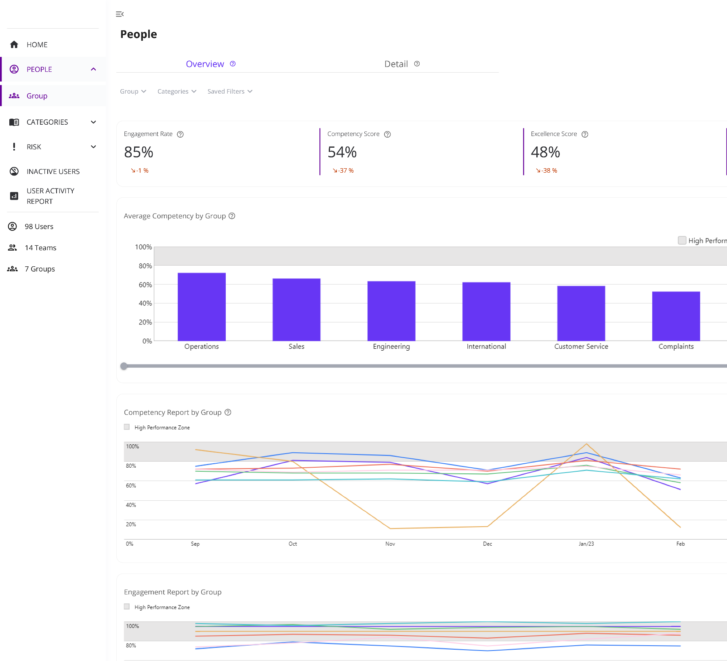
90-day Diagnostic Assessment
Data obtained during this period can be translated into actionable insights, informing any decisions you make about group training.
Best practice for milestone messages at months 3, 6 and 9*:
Consider what shareable metrics are available within your reporting dashboard, such as the top performing area for the group
Highlight a low performing area and provide supplementary reading material
*Only use non-personable data in these messages

Slide 19
Milestone message at 3 months
Hello team,
To mark our three-month milestone with Clever Nelly, we’d like to highlight the progress that we’ve made together!
Our top-ranking category is [add detail] with [x%] knowledge across the team and [number] questions answered correctly in total!
This is a brilliant accomplishment and will mean that we can benefit our customers by being more knowledgeable on [products / processes / services].
Currently, our lowest performing subject area is [add detail]. More information on this topic can be accessed [add detail about where to find learning material].
If you have any suggestions or feedback from the last three months, please let us know.
Many thanks,
[Sign off]
After your 90-day diagnostic assessment

Slide 20
Milestone message at 6 months
Hello team,
Now that we’ve utilised Clever Nelly for the last six months, I wanted to take a moment to recognise some of the brilliant examples of engagement and performance within our team.
[Include any recent success stories from your team’s engagement / knowledge scores – with permission]
We’re constantly looking at ways to get the most potential from Nelly’s learning opportunities.
If you have any questions or topics that you feel would make a real impact with our business and customers, please contact [add person].
Many thanks,
[Sign off]

Slide 21
Milestone message at 9 months
Hello team,
Clever Nelly has now been part of our team for the last nine months!
Over that time, we’ve been able to make great strides towards our original objectives to [include Compelling Story snippet].
As a result of your time and hard work, our customers are getting the best levels of service possible.
Many thanks,
[Sign off]

Slide 22
Celebrate knowledge improvement
Hello team,
Congratulations, we did it!
As a business, our knowledge score with Clever Nelly has reached over [80%], which is significantly higher than the average seen across other companies.
We could not have done this without your hard work and engagement – a huge thank you to everyone who has been actively contributing to our knowledge improvement!
[Optional element – reinforce your Compelling Story / KPI objectives]
The success of this project gives us a competitive edge in the market, allowing us to deliver on our customer expectations and company values.
Now that we’ve hit [80%], we’re moving onto the next stage of our journey with Nelly and will be introducing some scenario-based questions to further test and push ourselves.
Watch out for those in the next few weeks, and – as ever – let us know if you have any questions or ideas to put forward.
Many thanks,
[Sign off]

Slide 23
Celebrate engagement improvement
Hello team,
On behalf of [client / team name], we would like to extend our appreciation for the amazing uptake we have seen in our Clever Nelly engagement score over the last [month / week].
We have now reached over [80%] engagement, on average.
It has impressed the management team immensely to see such effort and enthusiasm for what we are trying to achieve across the business.
Despite having a busy schedule, it’s incredible to see that maintaining our knowledge remains a top priority and this will have a major impact to our customers.
Thank you once again for all the effort.
Many thanks,
[Sign off]

Slide 24
Introducing culture questions
Hello team,
Over the next few weeks, you will begin to notice some additional questions within Clever Nelly, focused on your workplace fulfilment and wellbeing.
To help us gauge a better picture of our culture at [client name], it’s really important to us that you answer these honestly, so that we can see where we are excelling and where we still need to make improvements.
We take pride in hiring and working with brilliant people; participating in these culture questions will ensure that we are able to make our culture as inclusive, forward-thinking and attractive as possible for the benefit of everyone who works here.
This series will be going live from [date] and [running continuously / ending on date].
Should you have any questions or comments, please speak to [add person].
Many thanks,
[Sign off]

Slide 25
Focus groups with your Account Director
Hello team,
As we’ve been working with Elephants Don’t Forget for over [time period] now, we’d like to find out how you are finding Clever Nelly so far.
Our dedicated Account Director – [name] – will be running a focus group to see where we’re currently benefiting from Nelly as a team and where we could stand to gain further improvements.
The next session will take place on [date].
If you’d like to put yourself forward to participate and voice any of your feedback and ideas, please contact [add person].
Many thanks,
[Sign off]

Slide 26
Feedback request
Hello team,
So that we can continue to support you, we would like to encourage participation in a feedback survey relating to our knowledge retention platform, Clever Nelly.
Whilst this is an optional request, your feedback is instrumental in helping us better understand where we can support you.
This should take approximately [number] minutes and all comments will be treated in confidence.
Please ensure that you have completed this by [date].
We appreciate your participation.
Many thanks,
[Sign off]

Slide 27
Critical tips to Creating Buy-in
1
2
3
4
5
Adopt continuous delivery in your communications
Pre-emptively address any questions or concerns
Cascade your Compelling Story
Employ a multi-media strategy
Involve everyone in the process

Slide 28
Thank you for your time.
Any questions?
ISO 27001 accredited organisation.
We financially underwrite the performance of our AI.
Tried & tested deployment process: it works every single time

