Slide 1
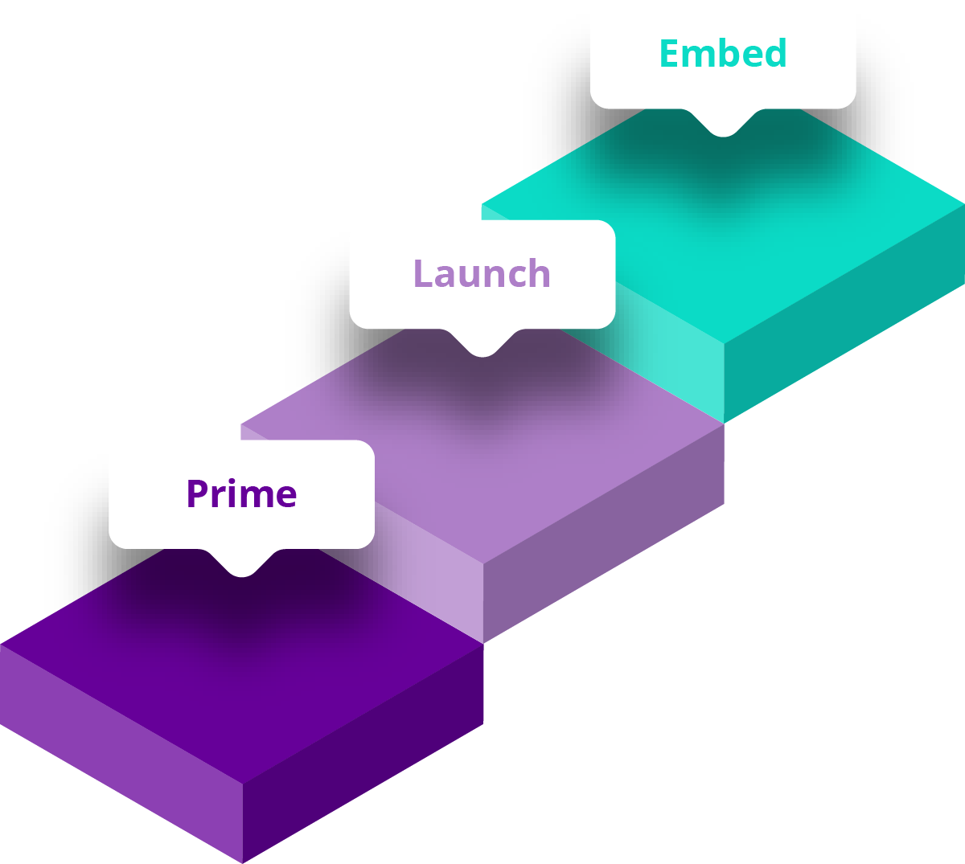


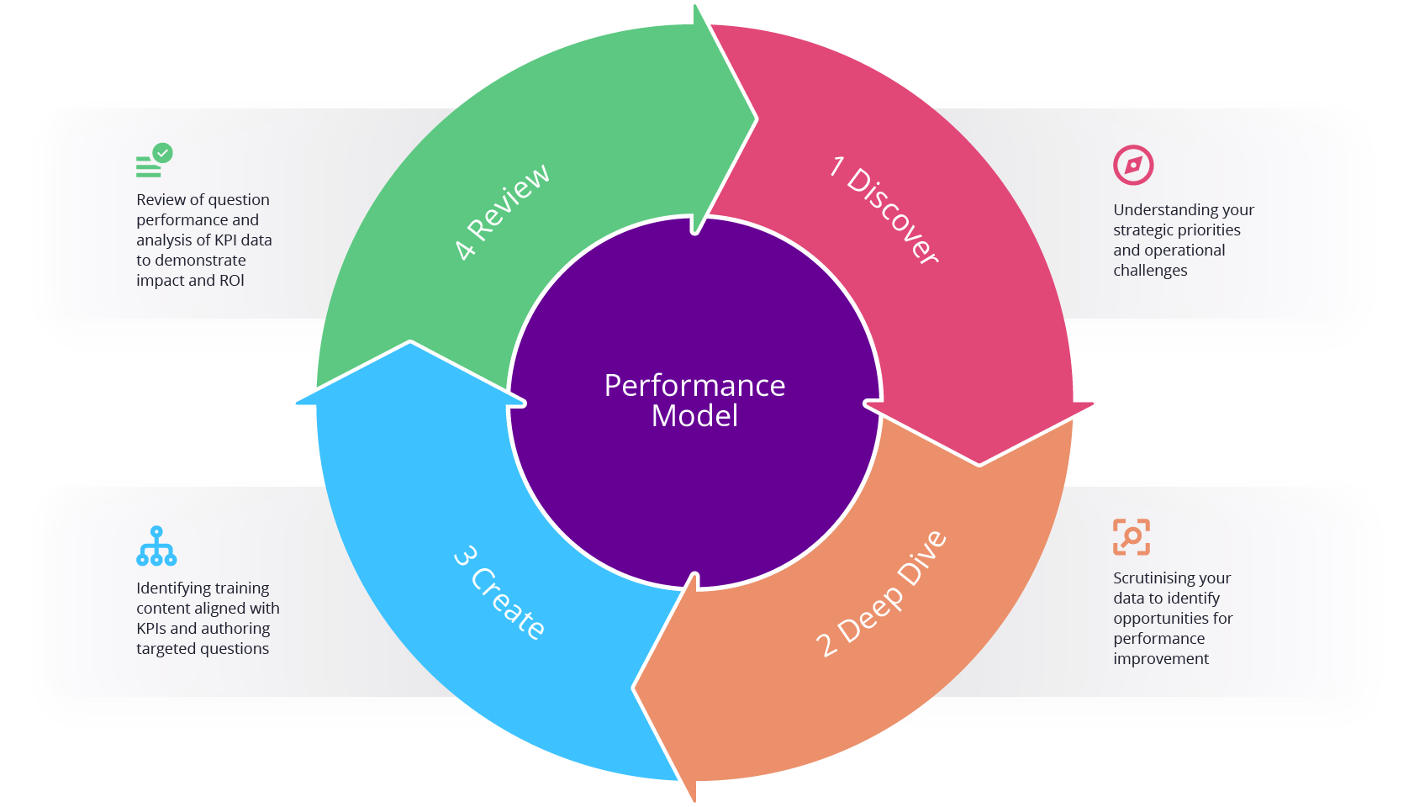
Performance Implementation
Implementation Team
EDF: Implementation Manager, AD/AM, Customer Support
Customer: Senior Sponsor, Project Lead, Content Owners/SME’s, Operational Managers, IT Contact
Prime
Prime
Launch
Embed
Discover
KPI Data
Shared
ROI Measure
Agreed
Kick Off
Compelling Story
Content
Briefing &
Alignment
Question Writing
& Reviews
Comms Plan
Manager
Engagement
Session
IT & Testing
Users
Launch
90 Day
Review
Senior Sponsor Project Lead
Data Lead
Senior Sponsor
Senior Sponsor Project Lead
Subject Matter Experts Content Owners
Operational Managers Team Leaders
IT Contact
Project Lead
Senior Sponsor Project Lead
Senior Sponsor Project Lead
Discover
Strategic Priorities
& Operational
Challenges
Deep Dive
Data - Analysis - Agreement
Create
Align the Content - Plan the Output - Create the Questions
Review
Question performance KPI Data & ROI
Performance Implementation Team
EDF: Performance Manager
Customer: Data Person

Slide 2
Compliance Implementation
Implementation Team
EDF: Implementation Manager, AD/AM, Customer Support
Customer: Senior Sponsor, Project Lead, Content Owners/SME’s, Operational Managers, IT Contact
Prime
Prime
Launch
Embed
Discover
Kick Off
Compelling Story
Content
Briefing &
Alignment
Question Writing
& Reviews
Comms Plan
Manager
Engagement
Session
IT & Testing
Users
Launch
90 Day
Review
Senior Sponsor Project Lead
Senior Sponsor Project Lead
Subject Matter Experts Content Owners
Operational Managers Team Leaders
IT Contact
Project Lead
Senior Sponsor Project Lead
Senior Sponsor Project Lead
Discover
Strategic Priorities
& Operational
Challenges
Create
Align the Content - Plan the Output - Create the Questions
Review
Question performance KPI Data & ROI

